Slide 1


Lead Scoring Case Study
Group Members
Priya Nayak
Puneet Bhasin
Rahul Chanchlani

Slide 2
Problem Statement
X Education sells online courses to industry professionals.
X Education gets a lot of leads, its lead conversion rate is very poor. For example, if, say, they acquire 100 leads in a day, only about 30 of them are converted.
To make this process more efficient, the company wishes to identify the most potential leads, also known as ‘Hot Leads’.
If they successfully identify this set of leads, the lead conversion rate should go up as the sales team will now be focusing more on communicating with the potential leads rather than making calls to everyone.
Business Objective:
X education wants to know most promising leads.
For that they want to build a Model which identifies the hot leads.
Deployment of the model for the future use

Slide 3
Solution Framework
Data cleaning and data manipulation
Check and handle NA values and missing values
Drop columns, if it contains large number of missing values and not useful for the analysis
Imputation of the values, if necessary
EDA
Univariate data analysis: value count, distribution of variable etc
Bivariate data analysis: correlation coefficients and pattern between the variables etc
Feature Scaling & Dummy Variables (encoding of the data)
Classification technique: Logistic Regression used for the Model building and Prediction
Validation of the model
Model presentation
Conclusion

Slide 4
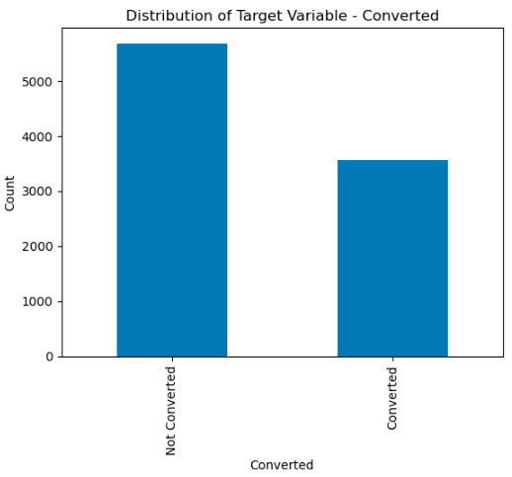
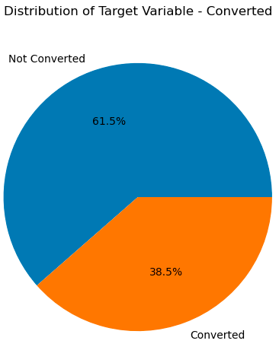
Distribution of Target Variable - Converted
Before EDA Analysis

Slide 5
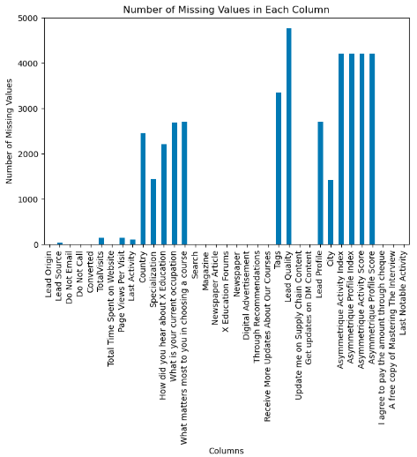
Missing Value Imputation
Features dropped due to Missing Values > 35%
Lead Quality - 51.59%
Asymmetrique Activity Index - 45.65%
Asymmetrique Profile Score - 45.65%
Asymmetrique Profile Index - 45.65%
Asymmetrique Activity Score - 45.65%
Tags – 36.29%

Slide 6
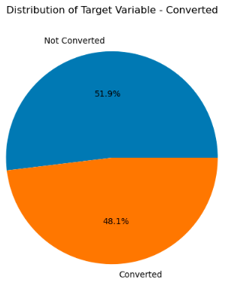
Data Cleaning
Dropping the below columns due to domination of level ‘Select’ which will yield no necessary input for machine to learn
Lead Profile
How did you hear about X Education
Dropping the below columns wherein one level is dominating over the other by a huge margin. E.g. dropping 'Do Not Call' column as there are 9238 No and only 2 Yes.
Do Not Call
Search
Magazine
Newspaper Article
X Education Forums
What matters most to you in choosing a course
Newspaper
Digital Advertisement
Through Recommendations
Receive More Updates About Our Courses
Update me on Supply Chain Content
Get updates on DM Content
I agree to pay the amount through cheque
Post Data Cleaning

Slide 7
Data Conversion & Model Building
Numerical Variables are Normalised
Dummy Variables are created for object type variables
Splitting the Data into Training and Test Sets
The first basic step for regression is performing a train-test split, we have chosen 70:30 ratio.
Used RFE for Feature Selection
Running RFE with 15 variables as output
Building Model by removing the variable whose p-value is greater than 0.05 and VIF is greater than 5
Model Evaluation & Predictions on Training set & Test set
Checking the Model Performance using the metrics like Accuracy, Sensitivity-Specificity view & Precision-Recall View

Slide 8
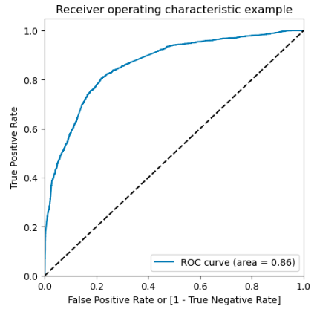
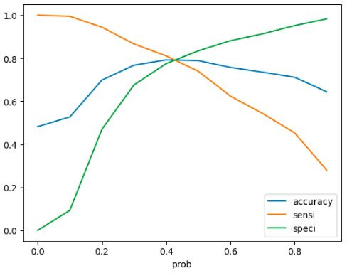
Model Performance: Sensitivity-Specificity View
Ideal Cut-off/Threshold: 0.42
Ideal Cut off is the probability where all the three metrics intersect
MODEL PERFORMANCE
Accuracy
- Training Set - 79.08
- Test Set - 78.45
Sensitivity
- Training Set - 79.33
- Test Set - 77.95
Specificity
- Training Set - 78.84
- Test Set - 78.91
ROC Curve

Slide 9
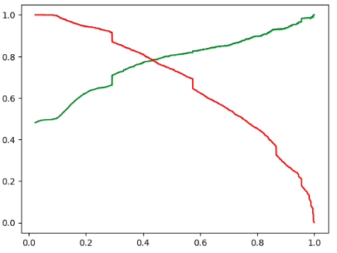
Model Performance: Precision-Recall View
Ideal Cut-off/Threshold: 0.44
Ideal Cut off is the probability where all the three metrics intersect
MODEL PERFORMANCE
Accuracy
- Training Set - 78.95
- Test Set - 78.66
Precision
- Training Set - 78.40
- Test Set - 78.28
Recall
- Training Set - 77.71
- Test Set - 76.75
ROC Curve

Slide 10
Conclusion
Based on the model that is created and its performance, it is concluded that the variables that mattered the most in the potential buyers are as below:
Total number of visits
Total time spend by the customer on the Website.
When the lead origin is Lead add format
When the lead source was:
Olark Chat
Welingak Website
When the last activity was:
Phone Conversation
When the current occupation stands out as Student
Keeping all the above points into consideration X Education can convert most of the leads and convince the potential buyers to buy their courses.

